Slide 1
Lecture 1: Why we model
Chapter 1
The Unified Modeling Language User Guide
By Grady Booch, James Rumbaugh, Ivar Jacobson

Slide 2
Unified Modeling Language
UML
UML is a standardized general-purpose modeling language in the field of software engineering. The standard is managed, and was created by, the Object Management Group (OMG) (http://www.omg.org/)
http://www.uml.org
What is Modeling?
A model is a simple representation of reality that helps us to understand how the system works.

Slide 3
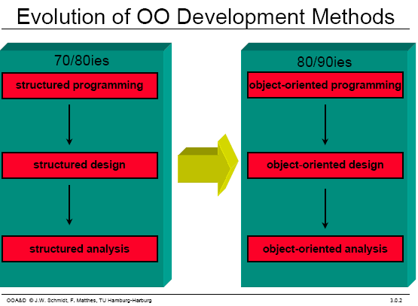
Software Development Evolution

Slide 4
UML History
OO languages appear mid 70’s to late 80’s
Between ’89 and ’94, OO methods increased from 10 to 50.
Unification of ideas began in mid 90’s.
Rumbaugh joins Booch at Rational ’94
v0.8 draft Unified Method ’95
Jacobson joins Rational ’95
UML v0.9 in June ’96
UML 1.0 offered to OMG in January ’97
UML 1.1 offered to OMG in July ’97
Maintenance through OMG RTF
UML 1.2 in June ’98
UML 1.3 in fall ’99
UML 1.5 http://www.omg.org/technology/documents/formal/uml.htm
UML 2.0 underway http://www.uml.org/
IBM-Rational now has
Grady Booch - Fusion
James Rumbaugh – Object Modeling Technique (OMT)
Ivar Jacobson – Object-oriented Software Engineering: A Use Case Approach (Objectory)
David Harel - StateChart
Rational Rose http://www-306.ibm.com/software/rational/

Slide 5
Why we Model
Modeling is the designing of software applications before coding. Modeling is an Essential Part of large software projects, and helpful to medium and even small projects as well.
Modelling is a proven and well-accepted engineering technique.
Unsuccessful software projects fail in their own unique ways, but all successful projects are alike in many ways.
There are many elements that contribute to a successful software organization; one common thread is the use of modelling.
We do model so that we can better understand the system we are developing.

Slide 6
What is a Model?
A model is a simplification of reality
A model provides the blueprints of a system.

Slide 7
Benefits of Model
Through modelling we achieve four aims:
Models help us to visualize a system as it is or as we want it to be
Models permit us to specify the structure or behaviour of a system
Models give us a template that guides us in constructing a system
Models document the decisions we have made

Slide 8
Limitation of Human Ability
The larger and more complex the system, the more important modelling becomes, for one very simple reason:
We build models of complex systems because we cannot full meaning of such a system in its entirety.
There are limits to the human ability to understand complexity. Through modelling we narrow the problem we are studying by focusing on only one aspect at a time.

Slide 9
Why use UML
Standardized graphical notation for
Specifying
Visualizing
Constructing and
Documenting software systems
Increase understanding/communication of product to customers and developers
Support for UML in many software packages today (e.g. Rational Rose, ArgoUML)

Slide 10
The UML is a language for Specifying
Specifying means building models that are precise, unambiguous, and complete
In particular, the UML addresses the specification of all the important analysis, design, and implementation decisions that must be made in developing and deploying a software-intensive system.

Slide 11
The UML is a language for Visualizing
Some things are best modeled textually; others graphically
The UML is more than just a bunch of graphical symbols
One developer can write a model in the UML, and another developer, or even another tool, can interpret that model unambiguously

Slide 12
The UML is a language for Constructing
UML is not a visual programming language, but its models can be directly connected to a variety of programming languages
It is possible to map from a model in the UML to a programming language such as Java, C++, or VB, or even to tables in a RDBMS

Slide 13
The UML is a language for Documenting
The UML addresses the documentation of a system’s architecture and all of its details
The UML also provides a language for expressing requirements and for tests
Finally, the UML provides a language for modeling the activities of project planning and release management

Slide 14
Review
Discuss

Slide 15
Building blocks of the UML
The vocabulary of the UML include three kinds of building blocks:
Things - abstractions that are first-class citizens in a model
Relationships - tie these things together
Diagrams - group interesting collections of things

Slide 16
Things in the UML
Structural things
Nouns/static of UML models (irrespective of time).
Behavioral things
verbs/dynamic parts of UML models
Grouping things
organizational parts of UML models
Annotation things
explanatory parts of UML models

Slide 17
Structural things
Structural things
are the nouns of the UML model. These are the mostly static parts of a model, representing elements that are either conceptual or physical.
There are seven kinds of structural things.

Slide 18

Structural things
A class
is a description of set of objects that share the same attributes, operations, relationships, and semantics.

Slide 19
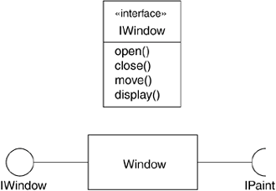
Structural things cont’d
An interface
is a collection of operations that specify a service of a class or component. An interface therefore describes the externally visible behavior of that element

Slide 20
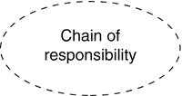
Structural things cont’d
A collaboration
Chain of responsibilities shared by interacting objects

Slide 21
Structural things cont’d
A Use case
is a description of set of sequence of actions that a system performs that yields an observable result of value to a particular actor.
Register
for Courses

Slide 22
Structural things cont’d
An active class
is a class whose objects own one or more processes or threads and therefore can initiate control activity. An active class is just like a class except that its objects represent elements whose behavior is concurrent with other elements.
Event Mgr
thread
Time
Start ()
suspend( )
stop( )

Slide 23
Structural things cont’d
A component
A replaceable part, realizes interfaces.
Course.cpp

Slide 24
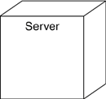
Structural things cont’d
A node
Computational resource that exists at run time
e.g., memory, processing capability.

Slide 25
Behavioral Things
Behavioral things
These are the verbs of a model.
Dynamic parts of UML models.
Representing behavior over time and space.
There are two kinds of behavioral things

Slide 26
Behavioral Things Cont’d
Interaction
A set of object exchanging messages, to accomplish a specific purpose accomplish a specific purpose.

Slide 27
Behavioral Things Cont’d
A state machine
specifies the sequence of states an object or an interaction goes through during its lifetime in response to events.
Msg: Vacation
Study
Vacation
Msg: Study

Slide 28
Grouping Things
Grouping things
are the organizational parts of UML models. These are the boxes into which a model can be decomposed. There is one primary kind of grouping thing, namely, packages.
Organizing elements (structural/behavioral) into groups.
Purely conceptual. only exists at development time. And can be nested.
Variations of packages are:
Frameworks, models, & subsystems.

Slide 29
Grouping Things Cont’d
University Administration
Course Manager
Course Manager
Student Admission
-Student
+Department

Slide 30

Annotational Things
Annotational things are the explanatory parts of UML models. These are the comments you may apply to describe, illuminate, and remark about any element in a model.
There is one primary kind of annotational thing, called a note.

Slide 31
Review
Discuss

Slide 32
Relationships in the UML
There are four kinds of relationships in the UML:
Association
Generalization
Realization
Dependency

Slide 33
Relationships in the UML Cont’d
An Association is a structural relationship that describes a set of links. A link is a connection between objects.
Variants: aggregation & composition
action
Student
attends
University

Slide 34
Relationships in the UML Cont’d
A Generalization
can be defined as a relationship which connects a specialized element with a generalized element. It basically describes inheritance relationship in the world of objects.
Student
Person
Teacher

Slide 35
Relationships in the UML Cont’d
A realization
can be defined as a relationship in which two elements are connected. One element describes some responsibility which is not implemented and the other one implements them. This relationship exists in case of interfaces.
Student

Slide 36

Relationships in the UML
A dependency
is a relationship between two things in which change in one element also affects the other one.

Slide 37
Diagrams in the UML
A diagram is the graphical presentation of a set of elements, most often rendered as a connected graph of vertices (things) and arcs (relationships). The UML includes nine such diagrams.

Slide 38
Diagrams in the UML Cont’d
Structural Diagrams
Represent the static aspects of a system.
Class Diagram
Object Diagram
Component Diagram
Deployment Diagram
Behavioral Diagrams
Represent the dynamic aspects of a system.
Use case Diagram
Sequence Diagram (Interaction)
Collaboration Diagram
Statechart Diagram
Activity Diagram

Slide 39
Review
Discuss

Slide 40
Diagrams in the UML
Class diagram
Object diagram
Component diagram
Composite structure diagram
Use case diagram
Sequence diagram
Communication diagram
State diagram
Activity diagram
Deployment diagram
Package diagram
Timing diagram
Interaction overview diagram

Slide 41
Diagrams in the UML
A Class diagram shows a set of classes, interfaces, and collaborations and their relationships. Class diagrams address the static design view of a system. Class diagram that includes active classes address the static process view of a system.
An object diagram shows a set of objects and their relationships. Object diagrams represent static snapshots on instances of the things found in class diagrams. These designs address the static design or process view of a system from the perspective of real or prototypical cases.

Slide 42
Diagrams in the UML
A component diagram shows an encapsulated class and its interfaces, ports, and internal structure consisting of nested components and connectors. Component diagrams address the static design implementation view of a system.

Slide 43
Diagrams in the UML
A Use case diagram shows a set of use cases and actors and their relationships. Use case diagrams address the static use case view of a system.

Slide 44
Diagrams in the UML
Both sequence diagrams and communication diagrams are kinds of interaction diagrams.
An interaction diagram shows an interaction, consisting of a set of objects or roles, including the messages that may be dispatched among them.
Interaction diagrams address the dynamic view of a system.
A sequence diagram is an interaction diagram that emphasizes the time-ordering of messages; a communication diagram is an interaction diagram that emphasizes the structural organization of the objects or roles that send and receive messages.
Sequence diagrams emphasize temporal ordering, and communication diagrams emphasize the data structure through which messages flow.

Slide 45
Diagrams in the UML
A state diagram shows a state machine, consisting of states, transitions, events, and activities. A state diagrams shows the dynamic view of an object.
An activity diagram shows the structure of a process or other computation as the flow of control and data from step to step within the computation. Activity diagrams address the dynamic view of a system. They are especially important in modeling the function of a system and emphasize the flow of control among objects.

Slide 46
Diagrams in the UML
A deployment diagram shows the configuration of run-time processing nodes and the components that live on them. Deployment diagrams address the static deployment view of an architecture. A node typically hosts one or more artifacts.
An artifact diagram shows the physical constituents of a system on the computer. Artifacts include files, databases, and similar physical collections of bits. Artifacts are often used in conjunction with deployment diagrams. Artifacts

Slide 47
Diagrams in the UML
A package diagram shows the decomposition of the model itself into organization units and their dependencies.
A timing diagram is an interaction diagram that shows actual times across different objects or roles, as opposed to just relative sequences of messages.
An interaction overview diagram is a hybrid of an activity diagram and a sequence diagram.

Slide 48
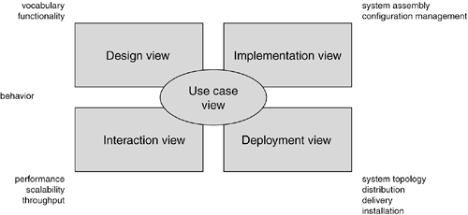
Modeling a System's Architecture

Slide 49
The UML Architecture
Visualizing, specifying, constructing and documenting a software intensive system demands that the system be viewed from a number of perspectives.
Different stakeholders- end users, analysts, developers, system integrators, testers, technical writers and project managers- each bring different agenda to a project, and each looks at that system in different ways at different times over the project’s life.

Slide 50
The UML Architecture
The use case view of a system encompasses the use cases that describe the behavior of the system as seen by its end users, analysts, and testers. With the UML, the static aspects of this view are captured in use case diagrams; the dynamic aspects of this view are captured in interaction diagrams, state diagrams, and activity diagrams.
The design view of a system encompasses the classes, interfaces, and collaborations that form the vocabulary of the problem and its solution. This view primarily supports the functional requirements of the system, meaning the services that the system should provide to its end users. With the UML, the static aspects of this view are captured in class diagrams and object diagrams; the dynamic aspects of this view are captured in interaction diagrams, state diagrams, and activity diagrams.

Slide 51
The UML Architecture
The interaction view of a system shows the flow of control among its various parts, including possible concurrency and synchronization mechanisms. This view primarily addresses the performance, scalability, and throughput of the system. With the UML, the static and dynamic aspects of this view are captured in the same kinds of diagrams as for the design view, but with a focus on the active classes that control the system and the messages that flow between them.
The implementation view of a system encompasses the artifacts that are used to assemble and release the physical system. This view primarily addresses the configuration management of the system's releases, made up of somewhat independent files that can be assembled in various ways to produce a running system. It is also concerned with the mapping from logical classes and components to physical artifacts. With the UML, the static aspects of this view are captured in artifact diagrams; the dynamic aspects of this view are captured in interaction diagrams, state diagrams, and activity diagrams.

Slide 52
The UML Architecture
The deployment view of a system encompasses the nodes that form the system's hardware topology on which the system executes. This view primarily addresses the distribution, delivery, and installation of the parts that make up the physical system. With the UML, the static aspects of this view are captured in deployment diagrams; the dynamic aspects of this view are captured in interaction diagrams, state diagrams, and activity diagrams.

Slide 53
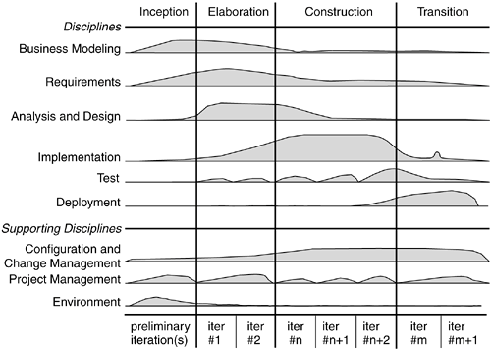
Software Development Life Cycle

Slide 54
Software Development Life Cycle
Inception is the first phase of the process, when the seed idea for the development is brought up to the point of being at least internally sufficiently well-founded to warrant entering into the elaboration phase.
Elaboration is the second phase of the process, when the product requirements and architecture are defined. In this phase, the requirements are articulated, prioritized, and baselined. A system's requirements may range from general vision statements to precise evaluation criteria, each specifying particular functional or nonfunctional behavior and each providing a basis for testing.
Construction is the third phase of the process, when the software is brought from an executable architectural baseline to being ready to be transitioned to the user community. Here also, the system's requirements and especially its evaluation criteria are constantly reexamined against the business needs of the project, and resources are allocated as appropriate to actively attack risks to the project.
Transition is the fourth phase of the process, when the software is delivered to the user community. Rarely does the software development process end here, for even during this phase, the system is continuously improved, bugs are eradicated, and features that didn't make an earlier release are added.
An iteration is a distinct set of work tasks, with a baselined plan and evaluation criteria that results in an executable system that can be run, tested, and evaluated.

Slide 55
References
http://www.cs.uah.edu/~rcoleman/Common/SoftwareEng/UML.html
https://pdfs.semanticscholar.org/a420/e56d5ad5aedf9740ffc7a1f62193cd0a8ba0.pdf

Slide 56
Review
Discuss
End of First Lecture

